Slide 1
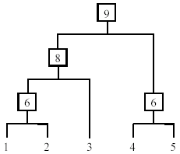
Hierarchical Clustering
Produce a nested sequence of clusters, a tree, also called Dendrogram.

Slide 2
Types of Hierarchical Clustering
Agglomerative (bottom up) clustering : It builds the dendrogram (tree) from the bottom level, and
Merges the most similar (or nearest) pair of clusters
Stops when all the data points are merged into a single cluster (i.e., the root cluster).
Divisive (top down) clustering : It starts with all data points in one cluster, the root.
Splits the root into a set of child clusters. Each child cluster is recursively divided further
Stops when only singleton clusters of individual data points remain, i.e., each cluster with only a single point

Slide 3
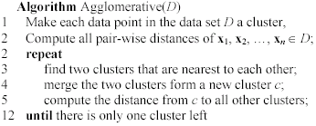
Agglomerative clustering
It is more popular than divisive methods.
At the beginning, each data point forms a cluster (also called a node).
Merge nodes/clusters that have the least distance.
Go on merging
Eventually all nodes belong to one cluster

Slide 4
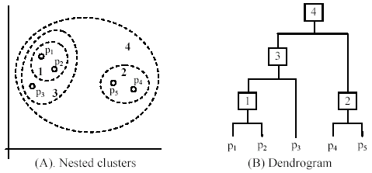
Example!

Slide 5
Measuring the distance of two clusters
A few ways to measure distances of two clusters.
Results in different variations of the algorithm.
Single link
Complete link
Average link
Centroids

Slide 6
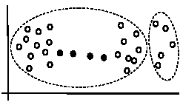
Single Link Method
The distance between two clusters is the distance between two closest data points in the two clusters, one data point from each cluster.
It can find arbitrarily shaped clusters, but
It may cause the undesirable “chain effect” by noisy points

Slide 7
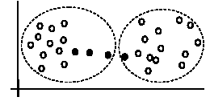
Complete link method
The distance between two clusters is the distance of two furthest data points in the two clusters.
It is sensitive to outliers because they are far away

Slide 8
Average link and centroid methods
Average link: A compromise between
the sensitivity of complete-link clustering to outliers and
the tendency of single-link clustering to form long chains that do not correspond to the intuitive notion of clusters as compact, spherical objects.
In this method, the distance between two clusters is the average distance of all pair-wise distances between the data points in two clusters.
Centroid method: In this method, the distance between two clusters is the distance between their centroids

